Slide 1
Capstone Project
Report
FINDING
BEST
AREAS IN CHENNAI
EDWIN ROOSEVELT

Slide 2
PROBLEM STATEMENT
Find the best areas to live in chennai.
The availability of jobs attracts People. This project aims to help people make smart and efficient choices in selecting the right areas to live in Chennai.

Slide 3
DATA
Data Sources
List of Neighborhoods in chenani is obtained from *wikipedia*.
Coordinates (latitude and longitude) data was obtained using geoPy api.
Each neighborhood area was explored using Foursquare api.

Slide 4
DATA
Data Cleaning
Spelling mistakes in the names of the areas had to be manually renamed.
Areas too close to each other were removed and only one area was left to remain.

Slide 5
METHODOLOGY
Coordinates of 131 areas were obtained using geoPy api.
Each area was explored for different venue categories using foursquare api.
1953 venues were obtained.
Venues were grouped into each areas.
Venue categories were grouped and irrelevant columns were dropped out.

Slide 6
METHODOLOGY
K-means clustering model was instantiated using the venue and location data.
The model clustered the areas into five categories.

Slide 7
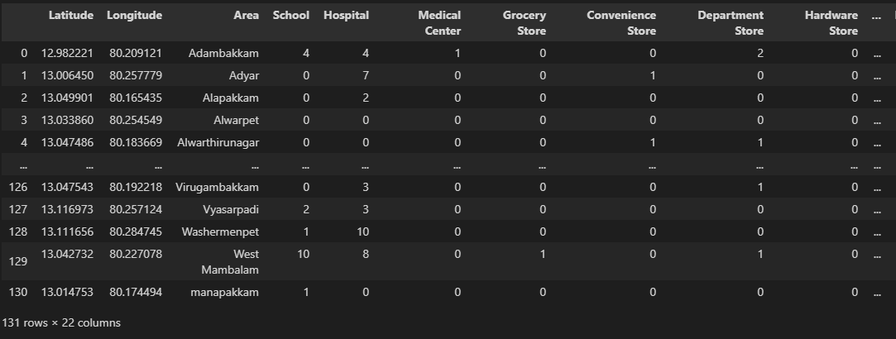
DATAFRAME

Slide 8
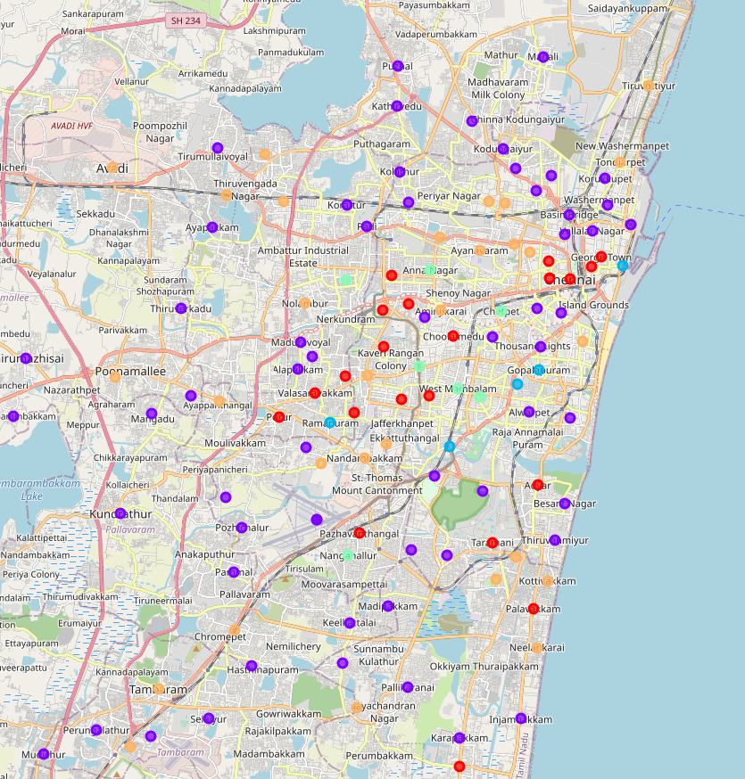
RESULT

Slide 9
RESULT
Cluster 1
These areas form the heart of chennai.
They have all the amenities but the cost of living is high.
Cluster 2
All the necessary venues are present in this cluster.
It is spread on the outskirts of the city.

Slide 10
RESULT
Cluster 3
These areas act as a transition between the heart and outskirts of the city.
Cluster 4
Unable to infer any correlation.
Cluster 5
Similar to cluster 1 with abundant restaurants (commercial zone)

Slide 11
CONCLUSION
Areas in cluster 2 and cluster 3 are the most favourable.
These areas are widespread.
Almost all the amenities are available in the areas of these clusters.

Slide 12
The End

